Slide 1
Telecom Customer Churn Prediction
Final Project - Group 5
Chloe Seo, Kaylee Vo, Kai Yeh, Sirisom Pranivong
CS109A, Fall 2024

Slide 2
Problem Statement
Visualization/EDA/Analysis
Model Flow & Training Detail
Results
Conclusion / Inferences
Future Work

Slide 3



Problem Statement
SITUATION
CHALLENGE
RESOLUTION
Telecom industry is a highly competitive and saturated market. Retaining existing customers is critical as acquiring new ones is costly and resource-intensive.
Identifying key factors influencing churn and their predictive value.
Analyzing service usage and financial metrics for churn impact.
Assessing the role of demographics in churn prediction.
Use machine learning models with F1-score optimization for churn prediction.
Leverage the best model to predict churn and identify key influencing features

Slide 4
Problem Statement
Visualization/EDA/Analysis
Model Flow & Training Detail
Results
Conclusion / Inferences
Future Work

Slide 5
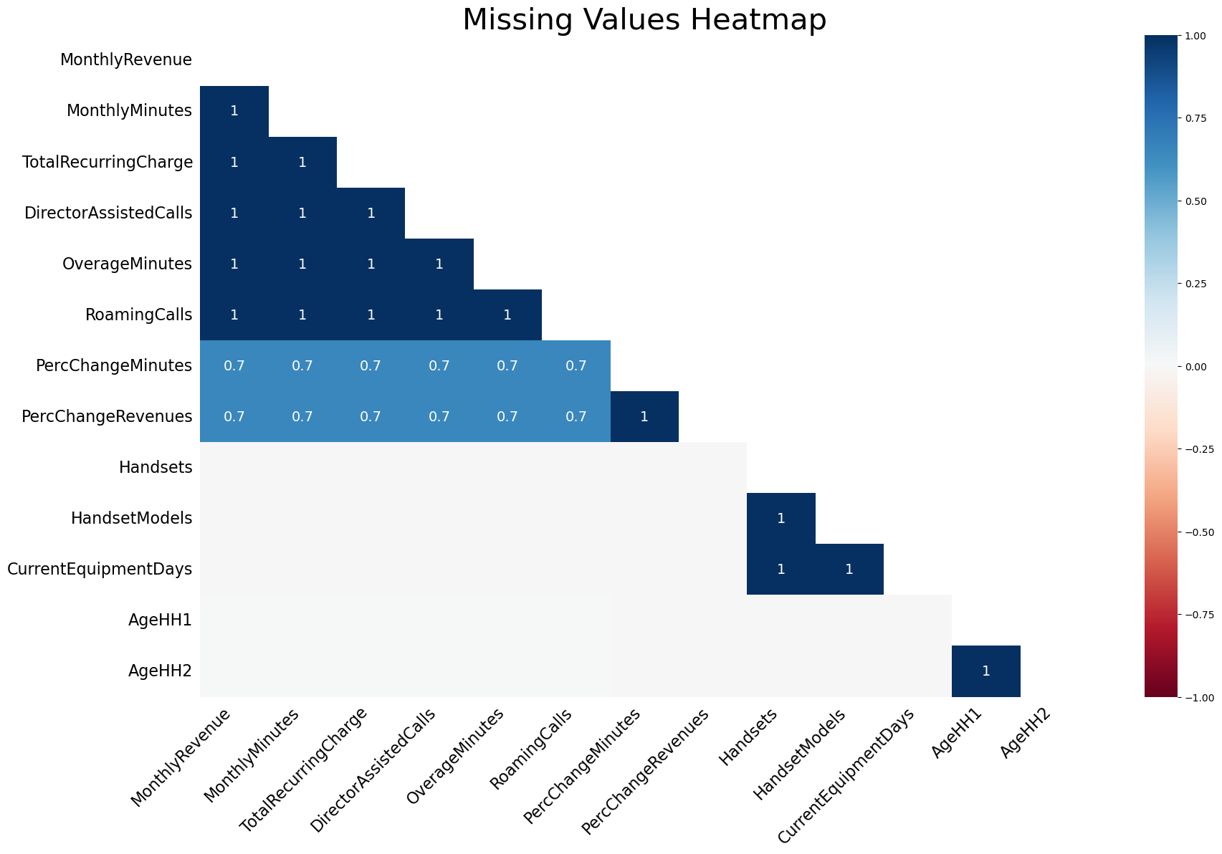

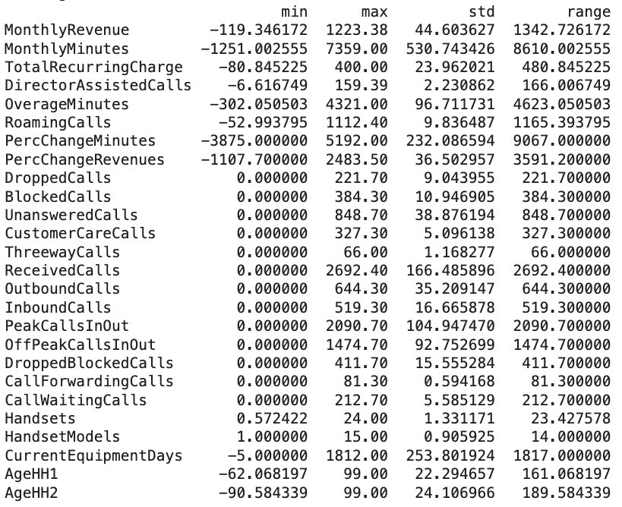

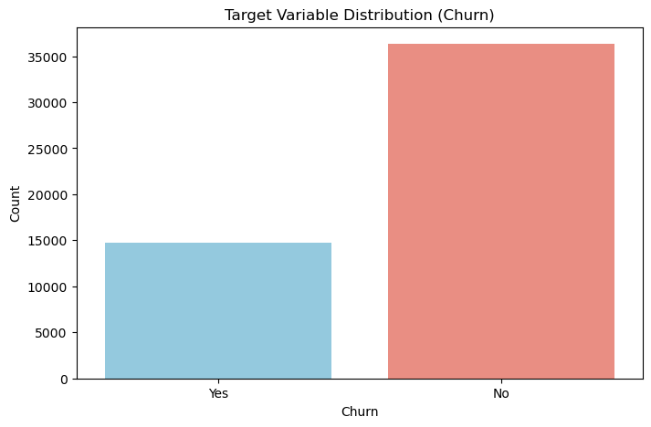

Data Preprocessing: Missingness, Scaling, and Imbalance
KEY OBSERVATIONS
Missingness: Addressed 14 columns and 1,295 rows of missing values using random regression imputation, leaving no missing values.
Data Scaling: Applied scaling for models like logistic regression (not random forest) before SMOTE to prevent data leakage.
Data Imbalance: Target variable, churn, imbalance (imbalance ratio: 0.40) was addressed using SMOTE and setting class weights to "balanced", achieving a 50:50 class distribution.

Slide 6
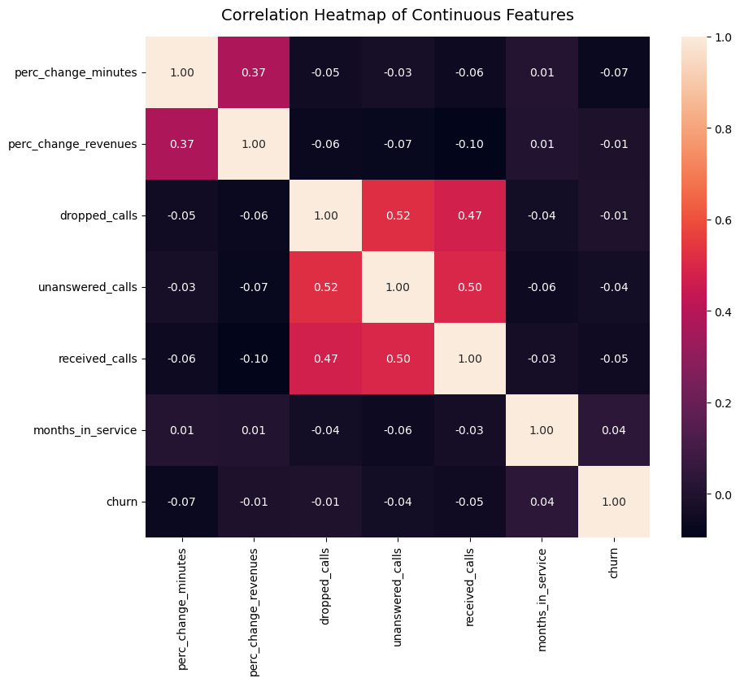
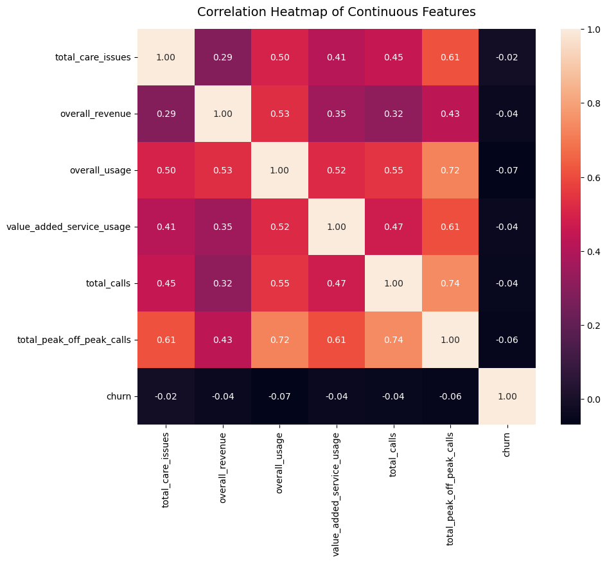
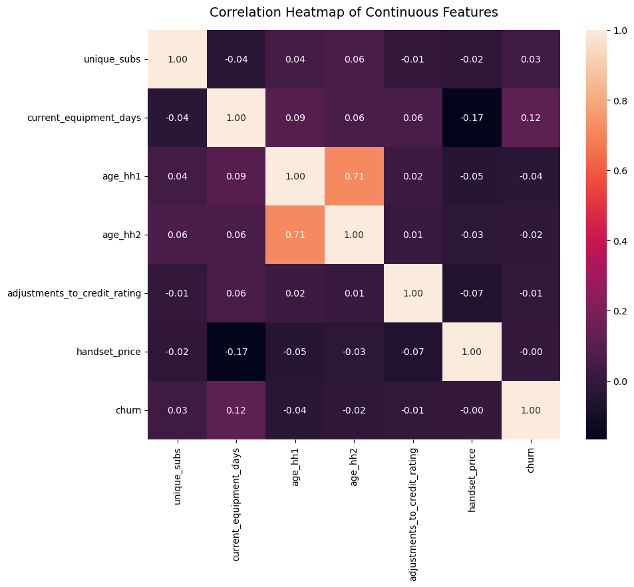
Feature Analysis: Correlation Heatmap of Continuous Features
KEY OBSERVATIONS
First Heatmap:
Shows multicollinearity (e.g., 'dropped_calls' & 'unanswered_calls': 0.52). Weak correlations with churn indicate multiple drivers
Second Heatmap:
Strong feature correlations (e.g., 'unique_subs' & 'active_subs': 0.79). Churn weakly related to these features.
Third Heatmap:
Usage features (e.g., 'total_calls') show moderate correlations, but churn links weakly with usage (-0.07).
SOURCE: MS5

Slide 7
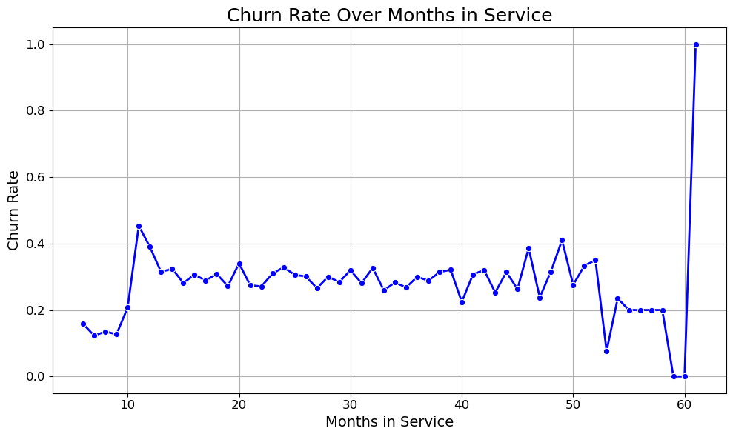
Feature Analysis: Churn Rate Over Months in Service
KEY OBSERVATIONS
10th Month: Churn peaks, likely due to contract expirations.
Stabilization: Churn remains between 0.2–0.4 for most months.
Post 50 Months: Fluctuations increase, with a spike at the 60th month (potential outlier).
Implication: Key points identified for targeted churn-reduction strategies.
.
SOURCE: MS5

Slide 8
Research Questions
Question 1
Which variables influence churn, and which model can most effectively predict customer churn?
1a
How do service usage, financial metrics and demographics impact churn?
Question 2
What is the causal estimate for the features "call to retention center" and "responds to mail offers"?
SOURCE: MS5

Slide 9
Problem Statement
Visualization/EDA/Analysis
Model Flow & Training Detail
Results
Conclusion / Inferences
Future Work

Slide 10
Model Development
Logistic Regression
The baseline model used top five correlated features, class weights, and no regularization.
The tuned model applied L1 regularization, scaling, SMOTE, and PCA on one-hot encoded variables.
Used OOB accuracy to find the optimal number of estimators to save computation cost. Trees were allowed to grow deep, no stopping conditions.
Compared level-order versus best-first growth. Selected the tree with the highest maximum OOB accuracy.
Tuned threshold, optimizing for F1-score.
Random Forest
Adaboost
Conducted random search with a large hyperparameter range and step size to determine most promising areas.
Utilized grid search for fine-grain search on promising areas.
Tuned threshold, optimizing for F1-score.
Gradient Boosting
Leveraged binning and native categorical variable support for quick computation.
Performed random search to identify promising areas and used grid search for fine-grain search.
Tuned threshold, optimizing for F1-score.
Boosting
SOURCE:

Slide 11
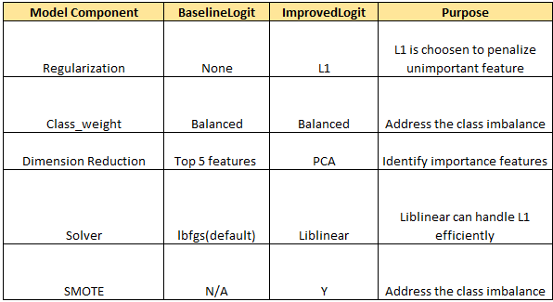
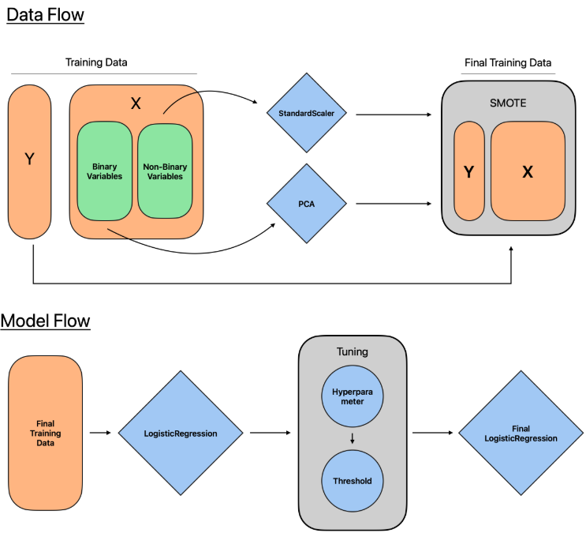
Logistic Regression
Methodology: Scaled, PCA on OHE variables, and applied SMOTE in this order to prevent data leakage.
Lasso Regularization: optimal lambda found through cross-validation.
TunedThresholdClassifierCV: Tuned the threshold, optimizing for F1-score, which balances precision and recall.
SOURCE:

Slide 12
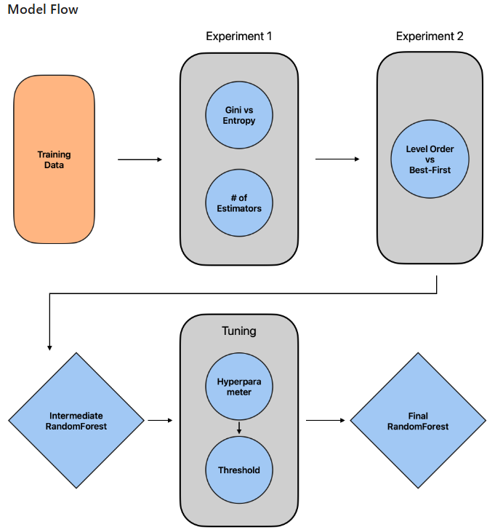
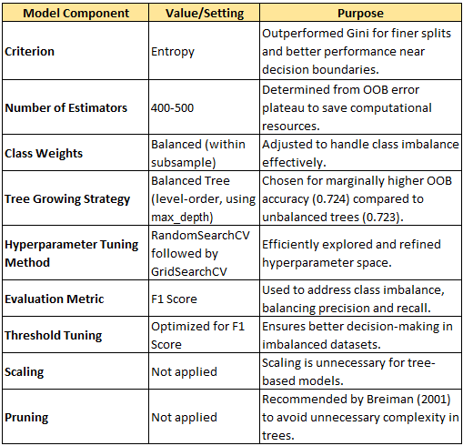
Random Forest
Random Forest was chosen for generalizability, complex boundaries, and reduced overfitting.
SOURCE:

Slide 13
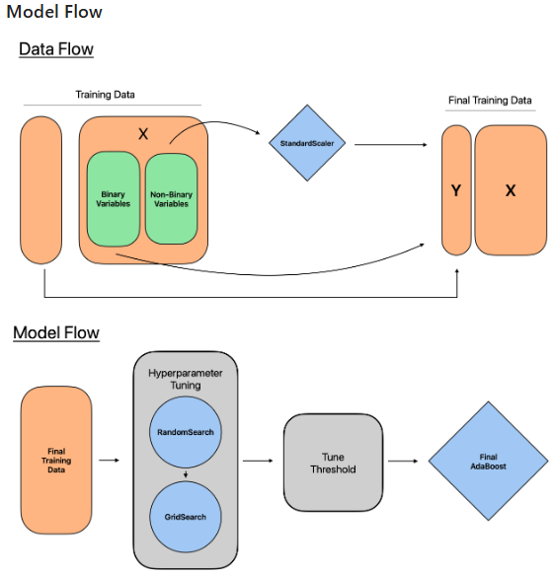
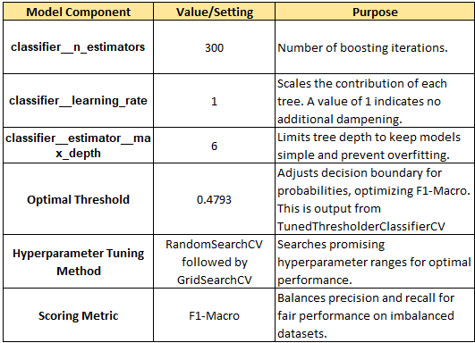
AdaBoost
Random Search: Explored the hyperparameter space to find areas that are most promising.
Grid Search: for a fine-grained search in the areas identified prior.
Threshold Tuning: Optimized the decision threshold to maximize F1-Score.
SOURCE:

Slide 14
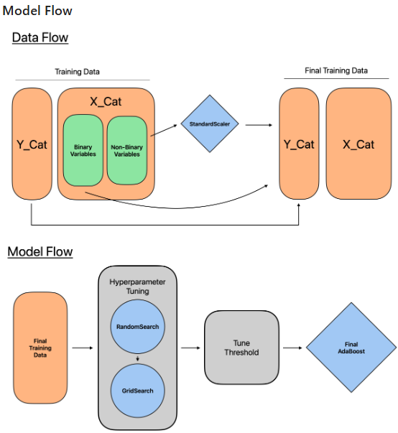
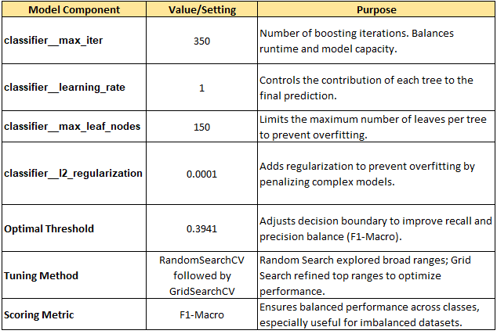
Gradient Boosting
Used binning and native categorical variable support to increase computation speed.
Used same strategy as AdaBoost.
1) Random search
2) Grid search
3) Tune threshold
SOURCE:

Slide 15
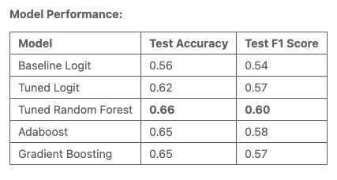
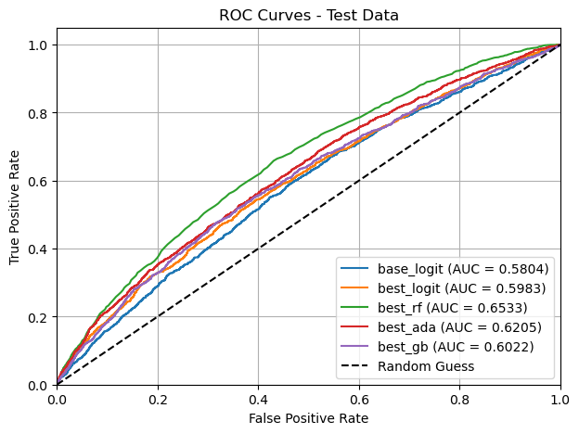
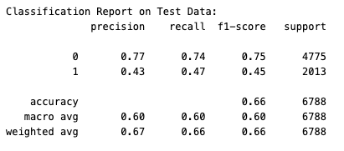
Best Model - Random Forest Model
KEY OBSERVATIONS
Random Forest achieved the best performance with a test accuracy of 0.66, F1-score of 0.60, and AUC of 0.6533. Although performs well for non-churn (0) customers (precision: 0.77, recall: 0.74), it struggles with churn (1) predictions (precision: 0.43, recall: 0.47), highlighting a need for improvement for churn cases.
SOURCE:

Slide 16


Prioritization Matrix
KEY OBSERVATIONS
High
1st Quadrant (High Impact, Easy): Random Forest: Best performance (F1-score: 0.60, AUC: 0.65) and efficient.
2nd Quadrant (High Impact, Hard): AdaBoost: Strong performance (F1-score: 0.58) but computationally expensive.
3rd Quadrant (Low Impact, Easy): Logistic Regression: Moderate performance (F1-score: 0.57) and simple to implement.
4th Quadrant (Low Impact, Hard): Gradient Boosting: Similar to Adaboost (F1-score: 0.57) but more resource-intensive.
2nd
AdaBoost
1st
Random Forest
Impact
4th
Gradient Boosting
3rd
Tuned Logit
Low
Hard
Easy
Ease
Ease: Use computational cost, runtime efficiency, or ease of implementation of each model.
Impact: Use metrics such as F1-score, AUC, or Test Accuracy.

Slide 17
Problem Statement
Visualization/EDA/Analysis
Model Flow & Training Detail
Results
Conclusion / Inferences
Future Work

Slide 18
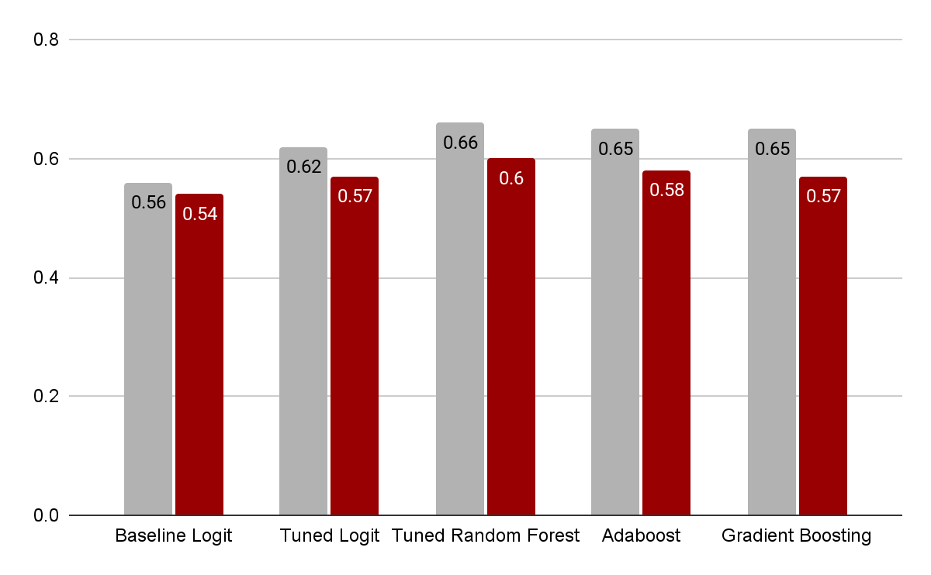

Model Performance
Test Accuracy
Test F1 Score
KEY OBSERVATIONS
Best Model: Random Forest
It achieved the highest test accuracy (0.66) and test F1-score (0.60).
It achieves the highest AUC (0.6533), confirming its superior ability to balance precision and recall across multiple thresholds.
Tuning improves performance:
The Tuned Logistic Regression outperforms the Baseline in both metrics, demonstrating the importance of model optimization.
Tuned Logistic Regression beats Baseline in AUC (0.5983 vs. 0.5804), reinforcing the value of optimization.
Boosting methods perform well but not as well as the Random Forest: Both Adaboost and Gradient Boosting have lower F1-scores (0.58 and 0.57, respectively) and lower AUC (0.62 and 0.60, respectively) compared to Random Forest.
Associate
Models
SOURCE: MS5

Slide 19
Problem Statement
Visualization/EDA/Analysis
Model Flow & Training Detail
Results
Conclusion / Inferences
Future Work

Slide 20
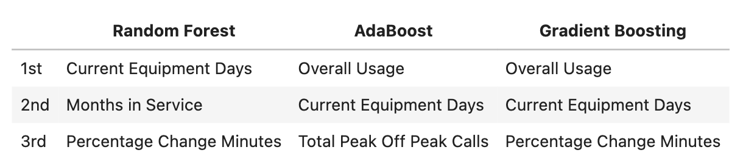
Feature Importance - Key Observations
Current Equipment Days
Older equipment may signal dissatisfaction and a search for better deals.
Overall Usage
“Overall Usage” is a combined feature that was created based on monthly minutes, overage_minutes (usage minutes that exceeds the contract agreement) and roaming call minutes. Customers who use the service less frequently might be less satisfied or are seeking other services that better fits their needs.
Percent Change Minutes
Percentage change in minutes used can indicate changes in customer behavior. A significant decrease might suggest that the customer is no longer actively using the service, potentially leading to churn.
Months in Service
The longer a customer has been with the service, the more likely they are to churn. This could be due to various reasons, such as dissatisfaction with the service or wanting to try something new.
Total Peak Off Peak Calls
Reduced call volume, especially during peak hours, might signal service quality issues.
SOURCE: MS5

Slide 21
Conclusion
Random Forest is the best model for predictive power and interpretability.
Key predictors of churn:
Service-related issues: Older equipment, decreasing usage, fewer peak-hour calls.
Customer tenure: Longer-tenured customers show higher churn risk.
Question 1
Service-related factors such as older equipment, decreasing usage, longer tenure, and reduced peak-hour calls can predict customer churn are significant drivers of churn.
Service usage : Strong correlation with churn. Low usage implies high churn.
Value-added service usage: showed moderate correlations with churn, indicating higher engagement may reduce churn risk.
Financial characteristics: Weaker predictors (e.g., monthly revenue, overage charges)
Demographic factors had limited predictive impact, with low feature importance scores in the models.
1a
Question 2
Call to Retention Center
ATE’s estimates were different between IPTW and matching but both effects were positive and significant.
Responds to Mail Offers
ATE’s estimates again were different between IPTW and matching but both effects were negative and significant.
SOURCE: MS5

Slide 22
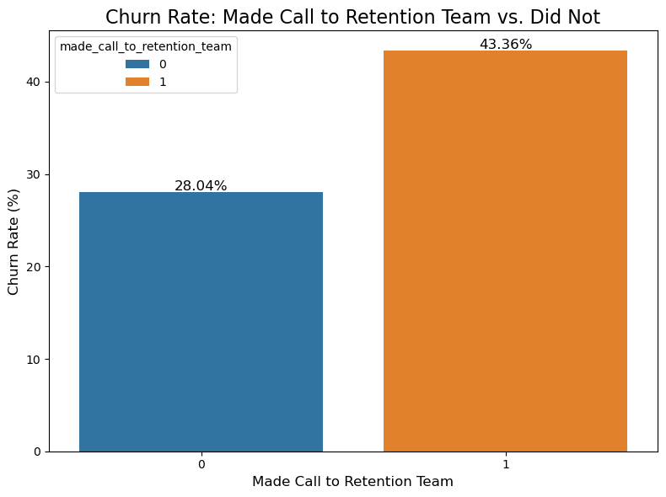
Does Making a Call to the Retention Team Causally Affect the Churn Rate, or Is It Just Correlated?
KEY OBSERVATIONS
Average Treatment Effect:
Matching: 12.75% increase in churn rate.
IPTW: 108% increase in odds of churn.
Insights:
Strong association between retention calls and higher churn rate.
Potential underlying factors (e.g., customer dissatisfaction) not captured in the dataset may influence both calling behavior and churn.
Decent propensity score overlap.
Recommendations: Re-train the customer retention team to address potential drivers of dissatisfaction.
Methodology enhancements:
Initial propensity score estimation revealed poor overlap (lasso logistic regression).
Used Inverse Probability of Treatment Weighting to estimate second ATE.
Simplified the propensity score model (logistic regression without regularization) to mitigate overfitting.
Associate
SOURCE:

Slide 23
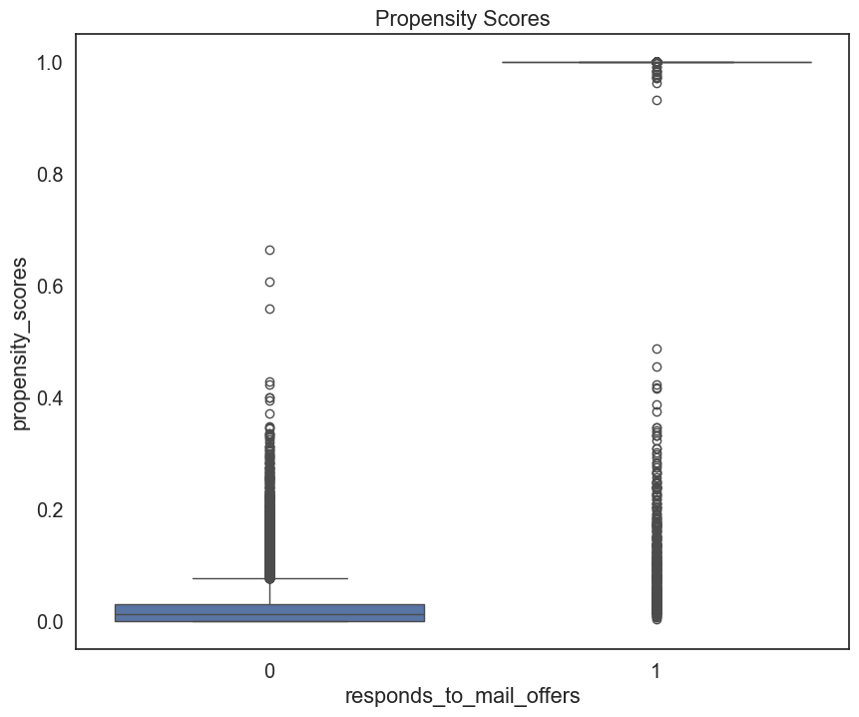

Does Responding to Mail Offers Causally Affect Churn, or Is It Just Correlated?
KEY OBSERVATIONS
Average Treatment Effect:
IPTW: 1.48% lower odds of churning
Matching: 70.45% decrease in churn rate.
Insights:
For IPTW, slightly lower churn rate among mail offer responders compared to non-responders.
Minimal difference suggests limited causal impact of mail offers on churn rates.
Large difference for matching.
Underlying factors (e.g., customer engagement) may influence both response behavior and churn.
Recommendations: Reassess the cost-effectiveness of mail offer campaigns, given the negligible impact on churn reduction.
Methodology:
Used propensity scores and inverse probability weighting to estimate an ATE with logistic regression
Good overlap in propensity score distributions after adjustment.
Limited evidence of a significant causal effect.
Associate
SOURCE: MS5

Slide 24
Problem Statement
Visualization/EDA/Analysis
Model Flow & Training Detail
Results
Conclusion / Inferences
Future Work

Slide 25
Future Work
Data Quality
Fix data quality issues by requesting a cleaner dataset from the call center.
Improved data will significantly enhance model accuracy and ATE estimates.
Feature Engineering
Develop new features to capture underlying patterns.
Explore nonlinear and interaction terms for better signal detection.
Advanced Models
Investigate ensemble methods like mixture of experts or model stacking.
Combine models to address different parts of the feature space.
Causal Inference
Conduct A/B test based on the most important features identified in the model to establish clear causality
SOURCE: MS5

Slide 26
Appendix

Slide 27
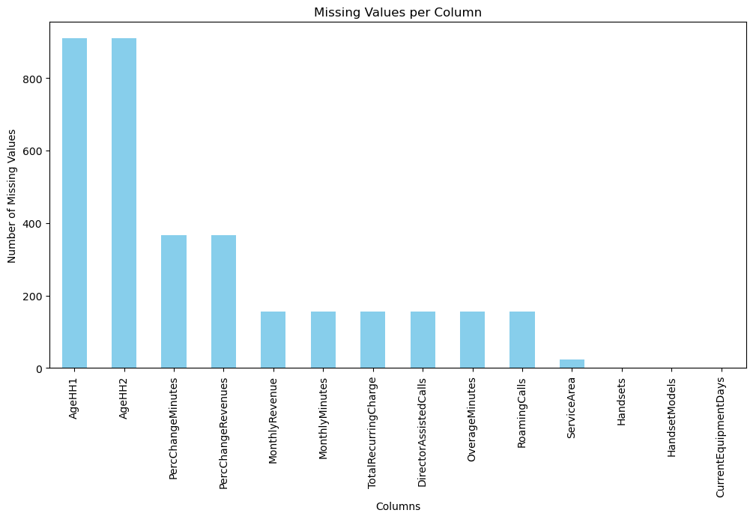
Data Missingness
KEY OBSERVATIONS
Missing Data:
14 columns and 1,295 rows had missing values.
Heatmap: Dark Blue (1.0) = perfect correlation, Light Blue (0.7) = moderate correlation, White = independent missingness.
Handling Missing Data:
New Users: For NewCellphoneUser == "Yes", PercChangeRevenues and PercChangeMinutes were set to 0.
Random Regression Imputation:
Used Linear Regression to predict missing values in numerical columns.
Added random noise (matching the standard deviation of known values) to maintain variability.
Outcome: No missing values remained in quantitative features after imputation.
SOURCE: MS2

Slide 28
Data Scaling
KEY OBSERVATIONS
EDA showed that features varied significantly in scale, making feature scaling necessary for some models like logistic regression.
Models that don't require scaling (e.g., random forest) excluded scalers from the pipeline.
Feature scaling was done before SMOTE to prevent data leakage. Scaling after SMOTE could introduce biases by incorporating synthetic data into the scaling process.
SOURCE: MS2 & MS5

Slide 29
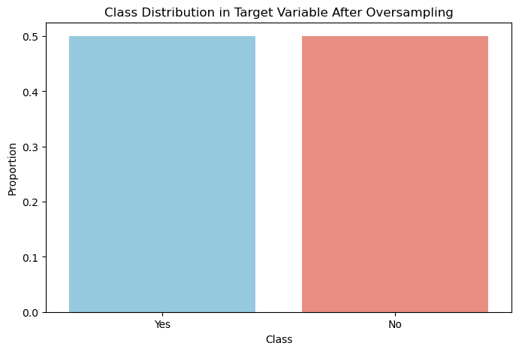
Data Imbalance: Target Variable (Churn) Distribution
KEY OBSERVATIONS
Class Distribution:
The target variable Churn was imbalanced, with 36,336 No (non-churn) and 14,711 Yes (churn).
Imbalance Ratio: 0.40.
Resampling Technique:
SMOTE: The Synthetic Minority Oversampling Technique (SMOTE) was used to oversample the minority class, addressing the class imbalance problem effectively.
Class Weights: Class weights were set to balanced (class_weight="balanced") to address class imbalance.
After resampling, the classes were evenly distributed (50% Yes, 50% No).
SOURCE: MS2 & MS5

Slide 30
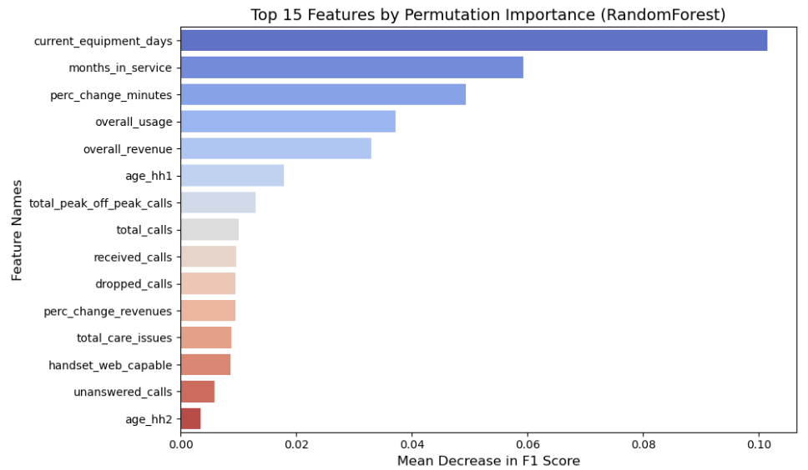
Top 15 Features by Permutation Importance
(RandomForest - Best Model)
SOURCE: MS5

